Slide 1
ORTHOPEDIC NURSING
BY JANE TERER

Slide 2
EXPECTATIONS

Slide 3
COURSE OBJECTIVES

Slide 4
MAIN OBJECTIVE
By the end of this Course, the learner will gain the necessary knowledge, skills and attitudes to promote health, prevent illness, diagnose, co-ordinate, manage and rehabilitate infants, children and adults suffering from orthopedic conditions.
4

Slide 5
SPECIFIC OBJECTIVES
Revise the structure and functions of the different tissues that compose the musculoskeletal system.
Outline bone healing
Describe the components of the nursing assessment, formulate a nursing diagnosis and give appropriate care to the person with musculoskeletal conditions; including: congenital talipes, osteogenic imperfect, hip dysplasia, rheumatoid arthritis, osteomylitis, TB of spine, scoliosis, ankylosis, traumatic fractures (potts, colles, humerus, radial/ulna pelvis, hip, femoral shaft/neck, tibia/fibula, spine, bone neoplasm’s, degenerative osteoporosis)
5

Slide 6
Specific Objectives cont’d
Explain the diagnostic test indicated for the person with musculoskeletal problem, the rationale for each test and appropriate nursing responsibilities associated with each test.
Describe the role of the nurse in the management of fractures and prevention of fracture-related complications.
6

Slide 7
Supporting Objectives
Review basic anatomy and physiology of bones and joints related to Orthopaedic nursing
Describe fractures and soft tissue injuries
Describe Orthopaedic inflammatory conditions:
Osteomyelitis
Rheumatoid Arthritis
Osteoarthritis
Pyogenic arthritis
Gout
Osteoporosis

Slide 8
Supporting Objectives Cont’d
Describe musculoskeletal system tumors
Describe congenital abnormalities of the musculoskeletal system (Talipes and Congenital hip dislocation/hip dysplsia), osteogenic imperfect
Care of the patient undergoing amputation

Slide 9
COURSE CONTENT
Review of Anatomy and Physiology of the Musculoskeletal System, bone healing
Fractures and Soft Tissue Injuries
Orthopaedic Inflammatory Conditions
Osteomyelitis
Pyogenic Arthritis
Rheumatoid arthritis and Osteoarthritis
Gout
Osteoporosis

Slide 10
Course Content cont’d
Tumors of the Musculoskeletal system
Congenital abnormalities of the musculoskeletal system
Talipes equinovarus
Congenital hip dislocation/hip dysplasia
Osteogenic imperfect
Diagnostic tests and Investigations indicated in Musculoskeletal pathologies
Medical management and the Nursing care of individuals with Musculoskeletal disorders.

Slide 11
REFERENCE ITEMS
Kathleen J; Waugh A; ( ); Ross and Wilson Anatomy and Physiology in Health and Illness; Ed. 12 © Churchill Livingstone.
Ignatavicius, D D; Workmann M L and Mary A Mishler (1995), Medical Surgical Nursing – A Nursing Process approach; Ed. 2 ; Vol.2 © WB Saunders.
Patrick; Woods; Craven; Rockosky and Bruno (1991), Medical Surgical Nursing – Pathophysiological concepts; Ed.2, ©JB Lippincott’s; pp. 1665 – 1781.
Rosdahl, CB.(1991), Textbook of Basic Nursing; Ed.5; pp. 734 – 759; © JB Lippincott's.

Slide 12
REFERENCE ITEMS Cont’d
Clark, RC & Bonfiglio, M (1994); Orthopaedics – Essentials of Diagnosis and Treatment; © Churchill Livingstone.
Mourad, LA (1991); Orthopaedic Disorders – Mosby’s Clinical Nursing Series; © Mosby-Year Books.
Miller DM (1992); Review of Orthopaedics; © WB Saunders Co.

Slide 13
INTRODUCTION
Orthopedics is the branch of medicine that deals with disorders or deformities of the skeletal system and associated muscles, joints and ligaments.
Orthopedic Nursing is a specialty focused on prevention and treatment of musculoskeletal disorders using the appropriate and scientific based nursing care.
13

Slide 14
ANATOMY AND PHYSIOLOGY OVERVIEW

Slide 15
ANATOMY AND PHYSIOLOGY OVERVIEW
The Musculoskeletal system function is interdependent with other body systems
The bony skeleton provides a supportive framework for body structures.
Bones also stores Ca²⁺ (98%), Phosphorous, magnesium and fluoride ions.
15

Slide 16
Anatomy and Physiology Overview cont’d
Red bone marrow produce red and white blood cells (Hematopoiesis)
Joints hold bones together and allow movement.
Muscles attached to bones helps moves bones and aid in heat production (maintain body temperature)
16

Slide 17
Anat… and Physio… cont’d
Bone Cell Types:
Osteoblasts for bone formation
Osteocytes for bone maintenance
Osteoclasts for destroying, resorbing and remodeling bone substance
17

Slide 18
Other related concepts
Ligaments
Ligaments are parallel bands of flexible, dense fibrous connective tissue whose primary function is to connect the articular ends of bones and provide stability.
They permit movement in some directions but limit movement in other directions hence preventing joint injury, as is the case with knee and hip joints.
Ligaments also attach to soft tissue to suspend structures e.g. the Suspensory ligament of the ovaries.
18

Slide 19
Tendons
Tendons are bands of dense fibrous tissues forming the origin and insertion of muscles.
They are aligned with sheaths, which is again lined with synovial membrane that provide lubrication for each tendon movement.
The sheaths enclose certain tendons especially in the wrist and ankle.
19

Slide 20
Fascia
This is a sheet of loose connective tissue that may be found directly under the skin as superficial fascia or as a sheet of dense fibrous connective tissue making up a sheath of muscles, nerves and blood supply.
20

Slide 21
Bursae
Are small sacs of connective tissue located whenever pressure is exerted over moving parts, hence preventing injury to muscle tendons.
Bursae are lined with synovial membranes and contain synovial fluid, which serve as cushion between the moving parts.
21

Slide 22
Joints
Are of three major types:
Fibrous (Synarthroses) joints: Allows no movement at all e.g. the sutures of the Skull.
Amphiarthroses (Cartilaginous) joints: Allows little movement e.g. the intervertebral joints and the joints at the pubic symphysis.
Diarthroses (Synovial): Allows free movements e.g. the hip joints.
22

Slide 23
Factors affecting bone formation
Factors influencing/responsible for bone formation:
Calcium level
Phosphorus
Enzyme Alkaline phosphatase (ALP)
Calcitonin
Vit. D
PTH
23

Slide 24
Factors enhancing bone formation cont’d
Growth Hormone (GH)
Glucocorticoids (Cortisol)
Sex hormone (Estrogen, Androgens)
Factors limiting bone formation
Infection and inflammation
Activity and Weight bearing
24

Slide 25
PHYSIOLOGY OF BONE HEALING
The process of bone healing is known as Callus Formation. Fractures and surgical interruptions of bone both heal by the same process and occurs in five major stages as follows:
Hematoma formation
Fibrin meshwork formation
Invasion of oesteoblast
Callus formation
Remodeling
25

Slide 26
Hematoma formation
Because bone is highly vascular, bleeding occurs at both ends of the fractured bone. Increased capillary permeability permits further extravasation of blood into the injured area.
Blood collects in periosteal sheath or adjacent tissues and fastens the broken ends together.

Slide 27
Fibrin meshwork formation
Fibroblast invade the hematoma forming a fibrin meshwork.
White blood cells wall off the area localizing the inflammation.
27

Slide 28
Invasion of oesteoblast
As oesteoblasts invade the fibrous union to make it firm, blood vessels develop from capillary buds, thereby establishing a supply for nutrients to build collagen and granulation tissue is formed.
Collagen strands become longer and begin to incorporate Ca²⁺ deposits leading to formation of cartilage.
28

Slide 29
Callus formation
Osteoblasts form a woven bony structure known as callus.
The osteoblasts continuously lay a network for the build up of bone, while osteoclasts destroy dead bone and help in the synthesis of new ones.
Ca²⁺ and phosphorus are deposited as mineral salts.
29

Slide 30
Remodeling
Excess callus is reabsorbed and new bone is laid down.
This is important because bone that has not undergone remodeling lacks the mechanical properties necessary for weight bearing.
30

Slide 31
Factors impeding callus formation
Inadequate/poor reduction of the fracture
Excessive edema at the fracture site impeding the supply of nutrients to the area of injury.
Excessive bone loss at the time of injury, which prevents sufficient bridging of the broken ends.
31

Slide 32
Factors Impeding Callus formation Cont’d
Inefficient immobilization
Infection at the site of injury.
Bone necrosis.
Anemia or other systemic conditions.
Endocrine imbalance.
Poor nutritional status.
32

Slide 33
FRACTURES

Slide 34

34

Slide 35
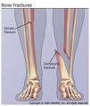
35

Slide 36
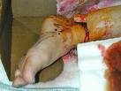
36

Slide 37
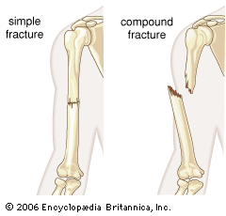
37

Slide 38
FRACTURES
A fracture is a discontinuity or break in a bone related to a blow, fall, accident, stress or disease process.
Avulsion fractures occur when a strong ligament or tendon pulls a fragment of bone away from the rest of bone.
Broken bones affect other adjacent structures.
38

Slide 39
Effects of fractures
Soft tissue edema
Hemorrhage into muscles and joints
Joint dislocation
Ruptured tendons
Severed nerve
Damaged blood vessels
Damaged body organs
39

Slide 40
Classification/Types of fractures
Fractures can either be:
Complete: There is a break across the entire bone;
Incomplete: Breakage occur partially;
Closed fracture: There is breakage but the skin remains intact; OR,
Open fracture: Involves the skin or mucus membrane.
40

Slide 41
Complete fractures
Complete fractures can be/includes
Simple(Closed)
Compound(Open)
Comminuted (Involves more than two fracture fragments)
Linear
Oblique
Spiral
Transverse
41

Slide 42
Complete fracture cont’d
Impacted
Pathological
Avulsion
Extracapsular
Intracapsular
42

Slide 43
Incomplete fractures
Incomplete fractures include
(i) Greenstick fracture
Torus fracture: There is buckling of the cortex caused by impaction;
Bowing fracture: The bone becomes curved along its longitudinal axis; OR
A transverse fracture occurring in the cortex and extending into the midportion of the bone but then becomes oriented along the longitudinal axis of the bone without disrupting the opposite cortex.
43

Slide 44
Incomplete fractures cont’d
(ii) Stress fracture: A very small crack in bone caused by unusual or repeated stress or heavy continuous weight on the ankle or leg; typically occurs in weight-bearing bones, such as the tibia and metatarsals bones and is a common sports injury, mostly associated with athletics.
(iii) Transchondral fracture: Involves entire thickness of cartilage down to subchondral bone.

Slide 45
Grading of Open fractures
Open fractures can be graded according to level/degree of contamination as follows:
Grade 1: Fracture with clean wound ≈1 cm or less.
Grade 2: Has a large wound with extensive soft tissue damage.
Grade 3: The wound is contaminated and there is extensive soft tissue damage.
45

Slide 46
CLINICAL FEATURES OF FRACTURES
Common clinical manifestations of fractures include:
Pain (swelling, muscle spasm)
Loss of normal function
Obvious deformity
Excessive motion at the site
Crepitus – the rattling sound or vibration produced by rubbing bone or irregular cartilage surfaces together.
46

Slide 47
Clinical features of fractures cont’d
Soft tissue edema
Warmth over injured area
Ecchymosis
Impairment or loss of sensation/paralysis
Signs of shock
Evidence of fracture on X-ray film
47

Slide 48
DIAGNOSIS OF FRACTURES
Read and make notes on:
Laboratory and Radiological tests in the Medical Diagnosis of Fractures.
History and Physical examination of individuals with musculoskeletal disorders.
48

Slide 49
MANAGEMENT OF FRACTURES

Slide 50
Objectives of Fracture Management
The major focus during the management of fractures aims at;
Reducing the fracture,
Immobilization, and
Rehabilitation.
50

Slide 51
IMMEDIATE MANAGEMENT
Maintain airway and assess for shock
Splint the fracture
Preserve correct body alignment
51

Slide 52
SECONDARY MANAGEMENT
Simple Fracture:
Reduction: closed reduction/manual manipulation
Traction
Immobilization (cast, wires, screws, plates)
52

Slide 53
Compound fracture
Surgical debridement
Wound culture
Wound dressing
Monitor infection (osteomyelitis, tetanus, gas gangrene)
Wound closure
Reduce fracture
Immobilize the fracture
53

Slide 54
Reduction
Is the restoration of the fracture fragments to anatomic alignment and rotation.
Reduction can be achieved in two ways:
Closed reduction: Aligning the bone through external manipulation/traction (cast, splint or other devices).
Open reduction: A surgical procedure (ORIF-Open reduction with internal fixation)
54

Slide 55
Disadvantages of internal fixation
Hypersensitivity to the devices; some patients may react to the internal fixator devices.
Damage to the bone and underlying tissues during the procedure.
Infections.
Bone overgrowth may occur as the bone excludes this plate.
High chances of failure rate.
It is expensive as it may need to be removed later

Slide 56
Immobilization
Immobilization is used to hold broken bones in contact to each other until healing takes place.
This can be achieved externally through external fixators such as casts, splints, braces and traction; or internally by use of metal plates and pins.
56

Slide 57
Traction
Is a mechanism that ensures a study pull is exerted on a part of or parts of the body to maintain adequate alignment.
Traction is used to reduce and immobilize fractures, and to maintain correct alignments.
It also helps in overcoming muscle spasms, correcting deformities and stretching adhesion.
57

Slide 58
Types of traction
Skin traction
The traction device is applied directly to the skin and attaching weights to them (Buck’s extension and Russel traction)
Hold 2-3.5 Kg (4.5 to 8 lb)
Pelvic traction-4.5-to 9 Kg (10 to 20 lb)
Monitor skin break down as a complication of traction
58

Slide 59

Skin traction
59

Slide 60

Skin traction
60

Slide 61
Skeletal traction
The traction device is applied directly to the bone.
Can hold 7-12 Kg (15-25 lb).
Potential complication include infection
61

Slide 62
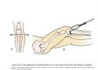
Skeletal traction
62

Slide 63
Principles of effective traction
Use counter-traction to achieve effective traction.
Traction must be continuous.
Skeletal traction is never interrupted.
Do not remove weight until advised
63

Slide 64
Always position the patient at the centre of the bed to help avoid poor body alignment.
Ropes must be unobstructed
Weight must hang free and not rest on the floor.
Knots on the rope or footplate must not touch the pulley or the foot of the bed.
64

Slide 65
CAST
Is a rigid external immobilizing device that is moulded to the contours of the body
Major purpose of the cast include:
To immobilize an already reduced fracture.
(ii) To correct the deformity.
(iii) To stabilize weakened joints.
65

Slide 66
Casting Materials
Fiberglass casts: Composed of water-activated polyurethane materials with the versatility of plaster but are more water resistant, lighter in weight and more durable than plaster
Plaster Casts:
Consists of rolls of plaster of Paris impregnated bandages wet in cool water and smoothly applied to the body.
Produces a rigid dressing within 15 – 20 minutes, but require a 1 – 3 days to dry completely depending on plaster thickness and environmental drying conditions.
66

Slide 67
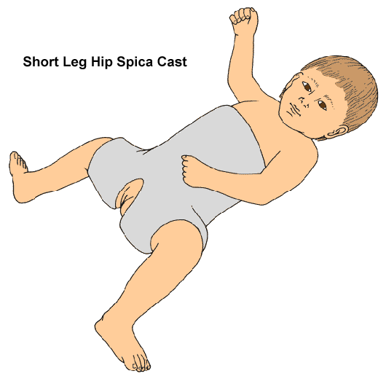
Types of cast
67

Slide 68
Types of casts
Short arm cast: Extends from below the elbow joint to the palmar crease, secured around the base of the thumb.
Long arm cast: Extends from the axillar fold to the proximal palmar crease, with the elbow immobilized at right angles
Short leg cast: Extends from below the knee to the base of the toes with the foot flexed at right angles in a neutral position.
68

Slide 69
Types of Casts cont’d
Long leg cast: Extends from the junction of the upper and middle 1/3rd of the thigh to the base of the toes; the knees may be slightly flexed.
Walking cast: A short or long- leg cast reinforced for strength
Body cast: Encircles trunk
Shoulder/hip spica: Body jacket that encloses the trunk shoulder and elbow for shoulder spica while the hip spica encloses the trunk and lower extremities.

Slide 70
Potential complications of a cast
Compartment Syndrome
Pressure ulcer
Disuse syndrome
70

Slide 71
Care of the Patient on a cast
Open fractures may not be treated with casts initially or if a cast is to be applied, a window may be required for dressing change
(i) The plaster must be kept dry
(ii) Assess skin under the cast for skin integrity
(iii) Spica casts should be avoided in abdominal distension
71

Slide 72
Assessment of pt on cast
Prevent neurovascular complications by assessing the 5 P’s:
Pain
Parasthesia
Pulses
Palor (colour)
Paralysis
Together with edema, temperature and capillary refill.
72

Slide 73
Bad/Danger signs may include:
Progressive unrelieved pain
Parasthesia
Motor loss
Sensory loss
Sensation of tightness
Coolness
Paleness
Slow capillary refill (<2-4 seconds)
73

Slide 74
Preoperative care of patient undergoing orthopedic surgery
1. Assess and for hydration status, medication histories and possible infections
2. Relieve pain through physical, psychological and pharmacologic strategies
3. Maintain adequate neurovascular function through assessment and prompt intervention
74

Slide 75
Pre-operative cont’d
4. Promote health by teaching coughing techniques, deep breathing and monitor fluid intake.
5. Improve mobility by elevating extremities and controlling pain.
6. Help pt maintain self esteem.
75

Slide 76
Post-operative care
Relieve pain.
Maintain adequate neurovascular function.
Improve and maintain physical mobility.
Promote and manage potential complications.
Promote home and community based care
76

Slide 77
Compartment syndrome
A complication of trauma in which there is increased pressure within a limited anatomical space compromising circulation, viability and function of the tissues within that space.
Restrictive space may be due to dressing, splint or even a cast.
77

Slide 78
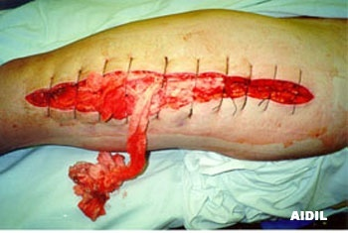
Compartment syndrome
78

Slide 79
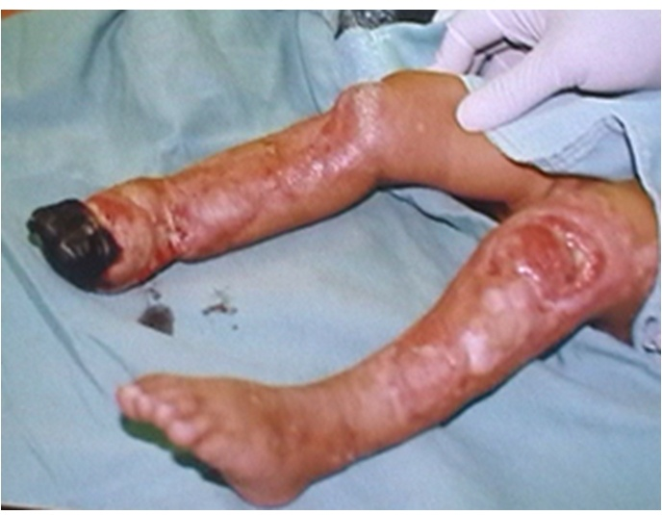
Compartment syndrome
79

Slide 80
Pathophysiology
Trauma------ fluid accumulates in compartment ----------- increased pressures --------- decreased blood supply------------- tissue hypoxia ------- increased permeability --------- compartment pressure continue to rise.
80

Slide 81
Management of C. Syndrome
Goals of management include:
1. To decrease tissue pressure.
2. To restore blood flow.
3. To preserve function of the affected limb.
Removal of external compression device by splitting cast may decrease the pressure
81

Slide 82
Management cont.
Surgical intervention;
Decompressive fasciotomy is indicated if conservative management fails.
82

Slide 83
Total Hip Replacement
Replacement of severely damaged hip with artificial joint.
Indicated mostly in patients over 60 years of age where regenerative bone healing may not be achievable following:
Arthritis (degenerative joint disease, Rheumatoid arthritis).
Femoral neck fracture.
Failed prosthesis/osteotomy
Congenital hip disease
83

Slide 84
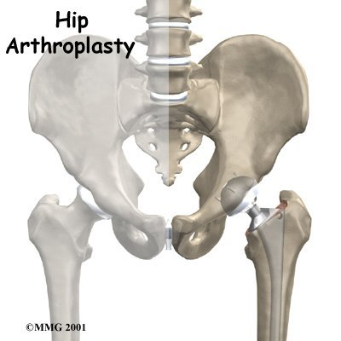
Hip Replacement cont’d
84

Slide 85
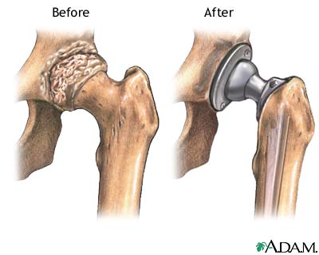
Hip Replacement cont’d
85

Slide 86
NURSING CARE OF THE PATIENT WHO HAS UNDERGONE TOTAL HIP REPLACEMENT

Slide 87
Nursing Care Cont’d
1. Monitor for possible complications such as:
Hip prosthesis dislocation
Excessive wound drainage.
Thromboembolism.
Infection.
Heel pressure and possible pressure sores
87

Slide 88
Nursing care cont’d
2. Monitor for other complications such as:
Heterotrophic ossification.
Vascular necrosis.
Loosening of the prosthesis.
88

Slide 89
Nursing care cont’d
3. Prevent hip dislocation by;
Maintaining the femoral head in the acetabulum.
Nursing the affected leg in a slightly abducted position.
Using an abduction splint or 2 – 3 pillows placed between the legs (wedge pillow).

Slide 90
Nursing care cont’d
4. Pt’s hip is never flexed more than 60 degrees
5. Flex the unaffected hip and use trapeze when giving bed pan.
6. Teach the patient not to flex the affected hip.
7. Use an abduction splint when moving the patient out of bed.
90

Slide 91
Signs of a possible dislocation include
Increased pain at surgical site, swelling and immobilization.
Acute groin pain at the affected hip or increased discomfort.
Shortening of the affected leg.
Abnormal extension or internal rotation.
Restricted ability/inability to move.
Report of a “popping” sensation by the patient
91

Slide 92
SOFT TISSUE INJURIES

Slide 93
Soft Tissue Injuries
Contusions
Strains
Sprains

Slide 94
Contusions
A Contusion is a soft tissue injury produced by a blunt force such as a blow, a kick or even a fall.
The small blood vessels rupture and bleed into soft tissues leading to ecchymosis or a bruise.
Hematoma may develop if bleeding is pronounced.
94

Slide 95
Symptoms of Contusion include
Pain
Swelling
Joint dislocation
Management strategies include
Intermittent application of cold compresses
Resting the affected limb
Most contusion resolve within 1-2 weeks
95

Slide 96
Strains
A strain is a muscle pull caused by overuse, overstretching or excessive stress on a muscle.
It is a microscopic, incomplete muscle tear, with some bleeding into the tissue.
Signs may include
Isometric muscle contraction
Sudden pain with local tenderness on muscle.
96

Slide 97
Sprains
A sprain refers to an injury to the ligaments surrounding a joint, commonly caused by a wrench or twisting.
A torn ligament loses its stabilizing ability
Common symptoms of sprain include:
Oedema
Tenderness which increase within 2-3 hours
Decreased movement
An X-ray film should be taken to rule out an avulsion fracture
97

Slide 98
Management of Soft tissue Injuries
The management of contusions, strains and sprains can be summed up with the acronym “RICE”
R = Rest
Resting the affected limb prevent additional injury and promote healing.
98

Slide 99
I = Ice
Application of cold compresses produces vasoconstriction hence decreasing the edema and discomfort associated with such injuries.
C = Compression
An elastic bandage provides pressure that controls bleeding, reduces edema and also supports the underlying structures.
E = Elevation
Elevating a limb controls swelling by increasing venous return to the central circulation.
Surgical repair is done for tone torn muscle and disrupted ligament.

Slide 100
JOINT DISLOCATION

Slide 101
Joint Dislocation cont’d
Is a condition in which the articular surfaces of the bones forming a joint are no longer in anatomical approximation to each other causing pain and impaired movement at such joints.
The impairment of the approximation of bone surfaces can be total or incomplete/partial, in which case the condition is referred to as a subluxation.
101

Slide 102
Joint dislocation cont’d
Dislocations can also be classified as:
Congenital: present at birth
Spontaneous or
Traumatic
A traumatic joint dislocation constitutes an orthopedic emergency which can lead to avascular necrosis and nerve palsy if not promptly treated, because the associated joint structures are distorted and severely stretched.

Slide 103
Joint dislocation commonly manifests with:
Pain on the affected joint and around it.
Change in joint contour
Change in length of the extremity involvd
Loss of normal mobility
Change in the axis of the dislocated bones
An X-ray film can be taken to help confirms the diagnosis
103

Slide 104
Management of J. Dislocation
Immobilize the affected joint/s
Promptly reduce the joint
Control pain
Monitor neurovascular status
Perform range of motion(ROM)
Educate pt on how to immobilize joint
104

Slide 105
ORTHOPEDIC INFLAMMATORY CONDITIONS

Slide 106
Common Inflammatory Conditions of Bones and Joints
Osteomyelitis
Arthritis:
Rheumatoid arthritis
Septic arthritis
Osteoarthritis
Gout

Slide 107
OSTEOMYELITIS

Slide 108
Osteomyelitis
Refers to infection of bone, which can occur following:
Extension of soft tissue infection.
Direct bone contamination.
Hematologic(blood-borne)dissemination
108

Slide 109
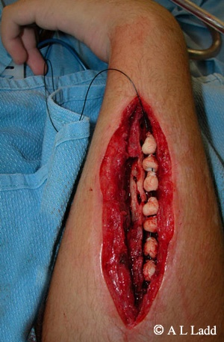
Osteomyelitis
109

Slide 110
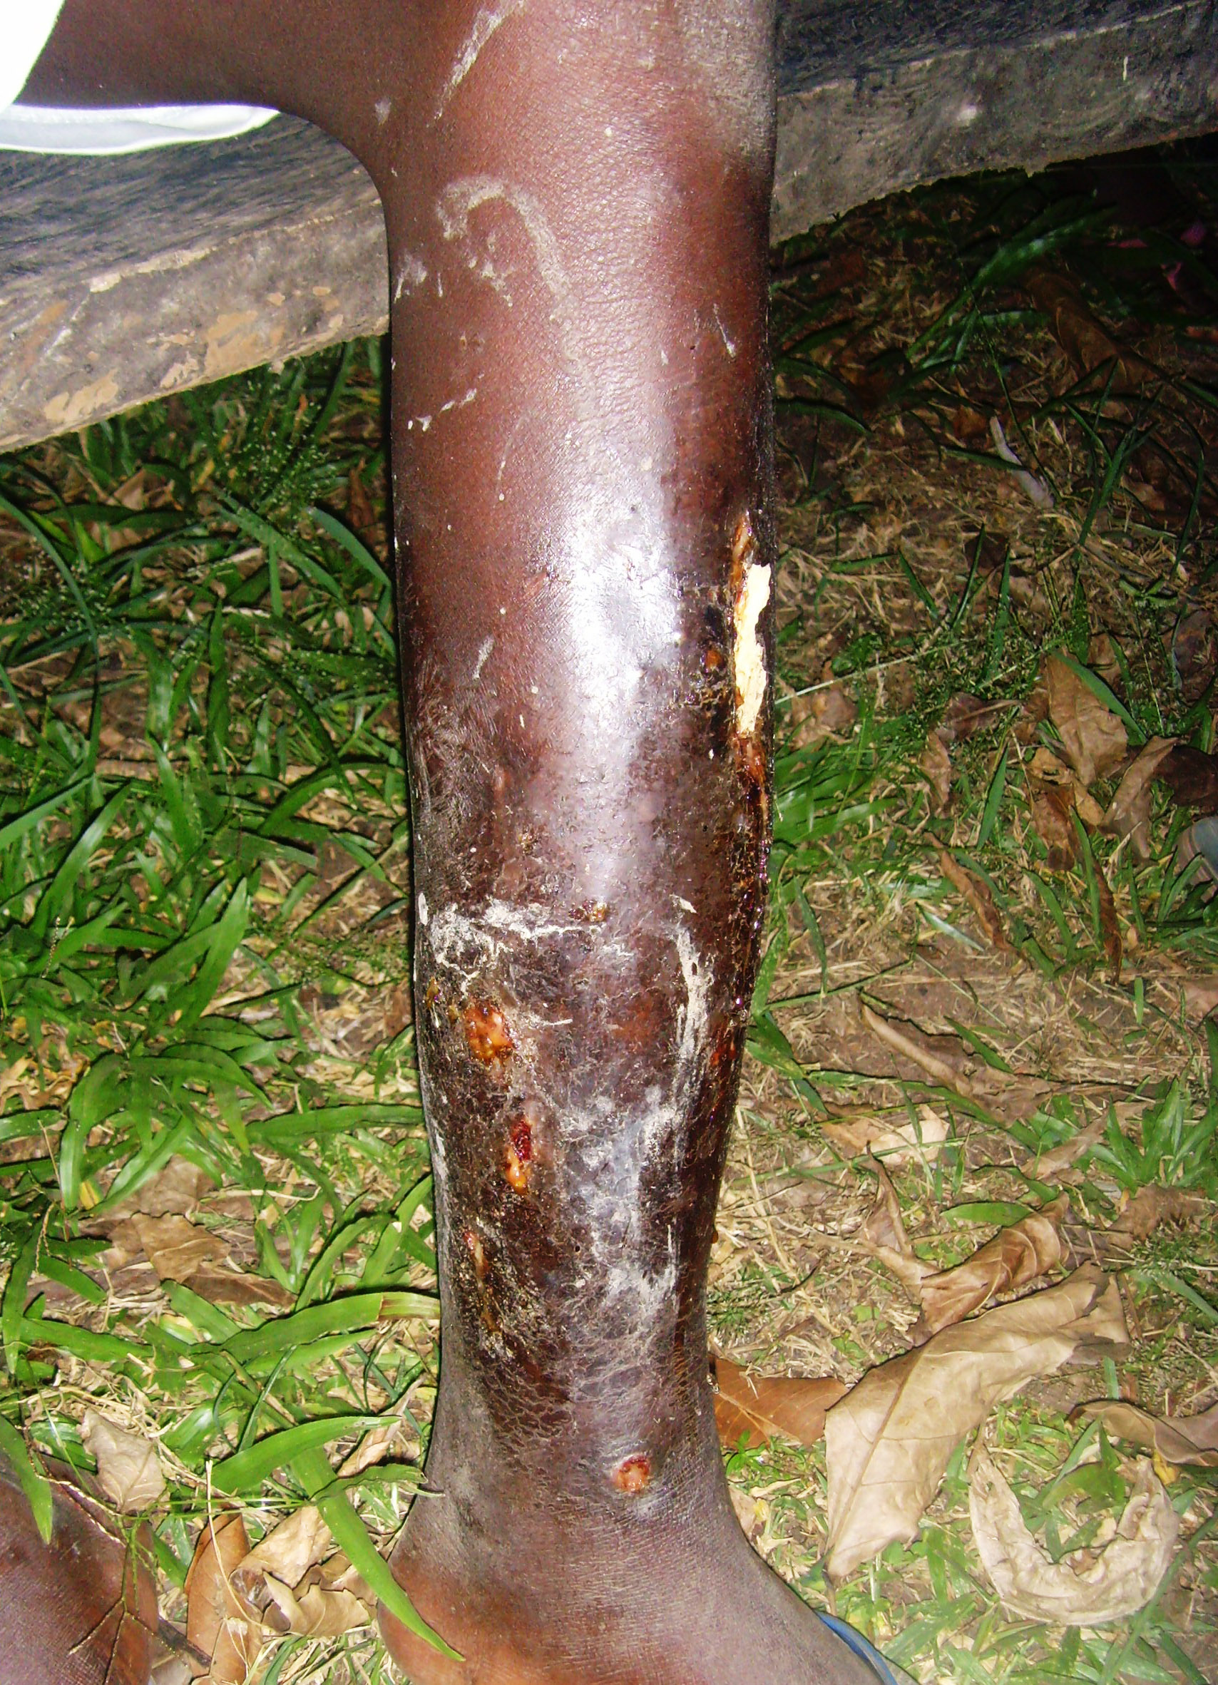
Osteomyelitis
110

Slide 111
Predisposing factor to Osteomyelitis
Malnutrition
Elderly /Old age
Obesity
Impaired immune systems
Post operative surgical wound which occur within 30 days after surgery
111

Slide 112
Causative organisms of Osteomyelitis
Staphylococcus aureus is responsible for approximately 70 – 80% of all bone infections.
Other causative organisms of bone infections include:
Proteus spp.
Pseudomonas spp.
Escherichia coli
112

Slide 113
Osteomyelitis cont’d
Bone infections are more difficult to eradicate than soft tissue infections.
This is because the affected bones become walled off; natural body immune responses are blocked and there is less penetration by antibiotics
Osteomyelitis may become chronic and affect quality of life.
113

Slide 114
Pathophysiology of Osteomyelitis
The initial response to infection is inflammation, increased vascularity, and edema. After 2 or 3 days, thrombosis of the blood vessels occurs in the area, resulting in ischemia with bone necrosis.
The infection extends into the medullary cavity and under the periosteum and may spread into adjacent soft tissues and joints.

Slide 115
Pathophysiology cont’d
Unless the infective process is treated promptly, a bone abscess forms.
This abscess cavity contains dead bone tissue called a sequestrum, which does not easily liquefy and drain.
Therefore, the cavity cannot collapse and heal, as occurs in soft tissue abscesses. New bone growth, called involucrum, forms and surrounds the sequestrum.

Slide 116
Pathophysiology cont’d
Although healing appears to take place, a chronically infected sequestrum remains and produces recurring abscesses throughout the patient’s life causing a chronic osteomyelitis.

Slide 117
Clinical features of Osteomyelitis
Onset is sudden
High fever and chills
Rapid pulse
General body malaise
Pain on the infected area.
117

Slide 118
Clinical features cont’d
(vi) Extreme tenderness
(vii) Chronic draining sinus.
(viii) Recurrent period of chronic pain.
(ix) Chronic inflammation and swelling
118

Slide 119
Diagnosis
Signs and symptoms
MRI
Elevated leukocyte level
Increased sedimentary rate
Wound culture
X-ray (early finding demonstrate soft tissue swelling)
119

Slide 120
Management of Osteomyelitis
Prevention of osteomyelitis should be the goal.
No elective orthopeadic surgery with infection.
Observe sepsis during surgery.
Prompt management of soft tissue infections.
Prophylactic antibiotics before invasive procedure.
120

Slide 121
Management cont’d
During treatment the goal is to control infection
Administer antibiotics
Ensure hydration
Provide appropriate diet
Correct anaemia
Immobilize the affected area
Apply warm wet soaks
Surgical-(sequestrectomy and debridement)
121

Slide 122
RHEUMATOID ARTHRITIS

Slide 123
Rheumatoid Arthritis
Arthritis is an inflammation of the joint, causing pain and stiffness.
Rheumatoid arthritis is a chronic, systemic disease characterized by recurrent inflammation of the diarthrodial joints, related structures and the surrounding tissues.
123

Slide 124
Aetiology
The exact cause of RA is not clearly understood
Theories suggesting:
Infection e.g with Epstern-Barr virus, the parvoviruses and mycobacteria may trigger the process.
Auto-immunity
Genetic factors
Others: such as metabolic and biochemical abnormalities, nutritional, environmental and occupational factors.
124

Slide 125
Pathophysiology of R. Arthritis
The disease progresses through four stages:
1. The unknown aetiologic factor initiate synovitis with swelling of the synovial membrane producing excess synovial fluid.
2. Inflammatory granular tissue called pannus is formed at the junction of the synovial membrane and cartilage.
This eventually spreads and invades the joint capsule and subchondrial bone.
125

Slide 126
Pathophysiology cont’d
3. A tough fibrous connective tissue replaces the pannus thus occluding the joint space. This results into fibrous ankylosis causing a decrease in joint motion and increased deformity.
4. As the fibrous tissue calcifies, bony ankylosis may result in total joint immobilization.
126

Slide 127
Systemic manifestations of R. Arthritis
Pulmonary
Cardiac
Vascular
Ophthalmological
Dermatological
Hematological
127

Slide 128
Clinical features of R. Arthritis
The signs and symptoms of RA are quite non specific and insidious. These may include
Fatigue
Anorexia
Weight loss, fever, malaise, morning stiffness of the joints.
Pain during rest and movement; night pains, edematous, erythematous “boggy joints”
History of precipitating stressful event
128

Slide 129
Clinical features of RA cont’d
Limitation of motion.
Signs of inflammation.
Bilateral joint symptoms (small joints).
Cervical joints may be affected.
129

Slide 130
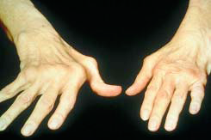
Advanced stage of R. Arthritis

Slide 131
Later symptoms
Pallor
Anemia
Colour changes of digit
Muscle weakness
Joint deformity
131

Slide 132
Later symptoms of RA cont’d
Paraesthesias
Decreased joint mobility
Contractures
Subluxation
Dislocation
Increased pain

Slide 133
Diagnosis
History and physical exam
Positive Rheumatic factor
Biopsy
Presence of immune complex and WBC in synovial fluid
133

Slide 134
Management of Rheumatoid Arthritis
The goal of therapy is to:
1. Relieve symptoms
2. Prevent joint destruction
3. Maintain joint functions
4. Promote independence and quality of life
134

Slide 135
Management of RA cont’d
Administer drug to control pain (NSAIDS, Corticosteroids)
Stabilize /Support the joints
Protect a joint or body part from external trauma.
Assist the patient to exercise specific joints
Apply cold pacts
Rest, exercise and diet are important
135

Slide 136
Management of RA cont’d
Surgery may be indicated to correct the deformity, relieve pain and restore function.
Educate the patient on balance of rest and activity, joint protection and energy conservation, proper use of medication and safety measures to prevent injury
136

Slide 137
SEPTIC ARTHRITIS

Slide 138
Septic Arthritis
In S. Arthritis, the joint become is either infected through infections from another part of the body or directly through trauma or surgical instrumentation.
Factors that may predispose to S. Arthritis include:
Trauma to the joints.
Joint replacement
Coexisting arthritis
Diminished host resistance
138

Slide 139
Causative organisms of septic arthritis
The leading causative agent is Staphylococcus aureus, followed by Streptococci and some gram negative organisms have also
Prompt recognition and treatment of infected joints are important because accumulating pus results in chondrolysis (destruction of hyaline cartilage)
139

Slide 140
Clinical Manifestations of S. Arthritis
The patient with acute septic arthritis usually presents with:
(i) A warm, painful, swollen joint with
decreased range of motion.
(ii) Chills and fever
(iii) Leukocytosis.

Slide 141
Diagnostic measures for S. Arthritis
Signs and symptoms
Culture of synovial fluid
Computed tomography
MRI
141

Slide 142
Management strategies of S. Arthritis
Broad-spectrum IV antibiotics are started promptly and then changed to organism-specific antibiotics after culture results are available.
Needle aspiration (Arthrocentesis) to remove excess fluid exudate, and debris.
Immobilize the joint in a functional position
142

Slide 143
S. Arthritis Management cont’d
Administer analgesia and anti-inflammatory agents such as NSAIDS.
Ensure proper/adequate nutrition and hydration.
Educate the patient on medication, the septic arthritis process, importance of supporting the affected joint and strategies to promote healing through aseptic dressing changes and proper wound care.

Slide 144
Osteoarthritis
Also known as Degenerative Joint Disease (DJD), this is a slowly progressive disorder of articulating joints, especially in the weight bearing joints.
It is characterized by degeneration of articular cartilage and overgrowth of bone.
Damage is localized to the joints and surrounding tissues
144

Slide 145
Aetiology of OA
May occur as Primary (Idiopathic) Osteoarthritis or Secondary, resulting from a previous joint injury or inflammatory disease.
Risk factors to Secondary OA may include:
Previous fractures.
Infections
Congenital deformities
Old age - usually seen in 50-70 years but may also occur as early as 45 years
145

Slide 146
Aetiology of OA cont’d
Other factors influencing development of osteoarthritis include:
Osteochondritis of head of femur esp. in children (congenital structural defects).
Metabolic disturbances such as obesity and overweight.
Repeated intra-articular hemorrhage
Septic arthritis
Excessive stress on joints through occupational or recreational repeated use.
146

Slide 147
Pathophysiology of OA
The factors responsible for OA development (genetic and hormonal factors, mechanical injury, previous joint damage or any other factor) stimulates a Chondrocytic response in the affected joint.
The stimulated chondrocytes releases chemokines and cytokines.
This leads to the Stimulation, production, and release of proteolytic enzymes, metalloproteases, collagenases.

Slide 148
Pathophysiology of OA cont’d
The resulting damage caused by the proteolytic enzymes and metalloproteases, further predisposes to more chondrocyte response leading to further damage.
With degeneration over time, bones become yellow and opaque with rough surfaces and areas of malacia (softening).
New bone outgrowth are formed at the joint margins and at the attachment sites of ligament.

Slide 149
Clinical manifestation of OA
Joint enlargement and Crepitus
Pain which increases with weight bearing
Limited joint motion
Morning stiffness (less than one hour)
Non-inflammatory effusion
Knocked knees
149

Slide 150
Management of OA
There is no specific management but therapy is aimed at symptomatic relief and control of pain.
Encourage appropriate nutritional intake to maintain ideal weight.
Behavioural change especially with occupation and exercises.
Surgical Intervention may be indicated.
150

Slide 151
GOUT
Gout is a heterogeneous group of conditions related to a defect of purine metabolism resulting in hyperuricemia (a uric acid serum concentration ˃ 7 mg/dL [0.4 fmol/L]).
Oversecretion of uric acid or a renal defect resulting in decreased excretion of uric acid, or a combination of both, occurs.
The incidence increases with age and body mass index and it tends to occur more commonly in males than females.
151

Slide 152
Gout cont’d
Is the principal manifestation of sustained hyperuricaemia.
Men are ten times more likely to have gout than women (At puberty male uric level rise and remain higher than those of females until menopause when female uric level rise)
Serum uric acid are related to Age, sex and genetic constitution.

Slide 153
Gout Classification
Gout can be classified as Primary or Secondary.
In Primary hyperuricemia, elevated serum urate levels or manifestations of urate deposition are due to faulty uric acid metabolism.
Primary hyperuricemia may be due to severe dieting or starvation, excessive intake of foods that are high in purines (shellfish, organ meats), or heredity.

Slide 154
Classification of Gout cont’d
In Secondary hyperuricemia, gout is a clinical feature secondary to any of a number of genetic or acquired processes.
Such processes may include conditions in which there is an increase in cell turnover such as leukemia, multiple myeloma, some types of anemias, psoriasis and even an increase in cell breakdown.

Slide 155
Gout cont’d
About 60% of uric acid is replaced daily and approximately 75% of uric acid is excreted in the kidney and remainder lost in the gut.
Uric acid is filtered at glomerulus and 90% is then reabsorbed
155

Slide 156
Causes of hyperuricemia
Prolonged use of diuretic drugs are the main cause but clinical gout is unknown
Renal failure
Increased production of uric acid: polycthaemia, hemolytic anemia, severe psoriasis and carcinomatosis.
Decreased renal excretion of uric acid-chronic renal disease, drug administration, reduction in fractional urate clearance
156

Slide 157
Causes of hyperuriceamia cont’d
The patient with Gout is usually obese, and drinks more alcohol. Dietary purines have a modest effect on plasma uric level
Short term alteration in diet such as starvation and ingestion of large amount of alcohol may cause hyperuricaemia by reducing renal clearance of uric acid due to increased lactic acid production which competes with uric acid excretion in the kidneys.
157

Slide 158
Pathophysiology of Gout
Prolonged hyperuricemia leads to crystal formation, which may accumulate in synovium and at external sites.
When crystal are phagocytosed there is interaction between the crystals and lysosomal membrane due to weak acid groups and membrane disruption follows.
Phagocytosis of urate leads to increased production of lactic acid which causes further precipitation of crystals.
158

Slide 159
Clinical features of Gout
Patient is obese
Pain usually early morning affecting the big toe.
Affected joints are usually red, swollen and warm
159

Slide 160
Precipitating factors of Gout
Joint trauma
Unusually physical exercise
Alcohol
High protein diet/starvation
Surgery
Drugs
Severe incidental illness
160

Slide 161
Diagnosis of Gout
History
X-ray
Serum uric level measurements
161

Slide 162
Management of Gout
The goal of treatment is to:
Reduce acute synovitis
Prevent further crystallization
Identify associated disease
Acute synovitis can be managed by NSAIDs and even Colchicine.
162

Slide 163
Management of Gout cont’d
Prevention of crystallization through:
Weight reduction, especially among obese and overweight individuals
Reduction of alcohol consumption
Evaluate need for diuretic drugs
163

Slide 164
OSTEOPOROSIS
Osteoporosis is a condition characterized by a reduction in bone density and change in bone structure.
In this case the rate of bone resorption is greater than that of bone formation resulting in reduced total bone mass, hence increasing susceptibility to fractures.
Bones are porous, brittle and fragile i.e. fractures easily under stress that would not break a normal bone.
Commonly results in compressed fractures of the thoracic and lumbar spine and intertrochanteric regions of femur.
164

Slide 165
Predisposing factors to Osteoporosis
Normal bone remodeling increases bone mass until early 30s.
Gender, race, genetics, aging, low body weight and body mass index, nutrition, lifestyle and physical activity influence peak bone mass and development of osteoporosis.
Osteoporosis is not a disease of the elderly but fractures occur with aging, onset occur in early life when bone mass peak begins to decline.
165

Slide 166
Pathophysiology of Osteoporosis
After peak bone mass is achieved, Calcitonin ,which inhibits bone resorption and promotes bone formation is decreased.
Estrogen which inhibits bone breakdown decreases with aging
Parathyroid hormone increases with aging increasing bone turnover and resorption resulting to loss of bone mass
Women develop osteoporosis more than men because of lower bone peak mass and the effect of estrogen loss during menopause
166

Slide 167
Factors affecting bone mass
Genetics
Nutrition
Age
Physical exercise
Lifestyle choices
Medication
167

Slide 168
Risk Factors
Small framed non-obese individuals
Race
Sex
Nutritional factors
Lifestyle
168

Slide 169
Diagnosis
X-Ray
Laboratory studies (calcium, serum phosphate)
169

Slide 170
Management of Osteoporosis
Adequate nutrition rich in calcium and vitamin D throughout life, with an increased calcium intake during adolescence, young adulthood, and the middle years, protects against skeletal demineralization.
Calcium supplementation e.g., Caltrate®, Citrocal® may be prescribed and taken with meals or with a beverage high in Vit. C to promote absorption.
Regular weight bearing exercises to promotes bone formation.
170

Slide 171
Management of Osteoporosis cont’d
(iv)Hormonal Replacement Therapy (HRT) with estrogen and progesterone, especially at natural or surgical menopause.
(v)Calcitonin to suppress bone loss.
(vi)If the patient has a fracture, manage appropriately depending on the condition.

Slide 172
Prevention of Osteoporosis
Early identification of at risk teenagers and young adults
Regular weight bearing exercise.
Modification of lifestyle (caffeine, cigarettes and alcohol)
Observe for precipitating factors.
172

Slide 173
Osteomalacia
Is a metabolic bone disorder characterized by inadequate mineralization of bone.
Faulty mineralization leads to softening and weakening of the skeleton.
173

Slide 174
Pathophysiology of Osteomalacia
Deficiency of Vitamin D (calcitriol) which promotes calcium absorption from GI leads to low calcium and phosphate movement to calcification.
Osteo-malacia may result from failed calcium absorption (malabsorption syndrome) or from excessive loss of calcium from the body.
GI disorders –fats are inadequately absorbed are likely to produce osteo-malacia through loss of calcium and Vit D, the first being excreted in feces.
174

Slide 175
Pathophysiology cont’d
Liver and kidney diseases can produce lack of Vit D because these are organs that convert Vit D to its active form.
The malnutrition type of Osteomalacia is as a result of poverty
175

Slide 176
Clinical manifestations of Osteomalacia
Softening and weakening of the skeleton.
Pain and tenderness to touch.
Bowing of the bones
Pathologic fracture
On exam–skeletal deformity (spinal kyphosis and bowed leg)
Limping gait
176

Slide 177
Diagnosis for Osteomalacia
History of the presenting disorder.
X-ray film reveals a generalized demineralization of bone.
Serology reveals a low serum calcium and phosphorous level with a moderately elevated concentration of alkaline phosphatase.
Urinalysis excretion of calcium and creatinine is low.
Bone biopsy reveals an increase in osteoid levels.
177

Slide 178
Management of Osteomalacia
Correct the underlying cause/disorder.
Increase dose of Vit D with supplement calcium, if the disorder is due to malabsorption. (High doses of Vit. D are toxic hence adequate monitoring is very necessary).
Sunlight exposure to promote Vit. D utilization.
178

Slide 179
Management of Osteomalacia cont’d
Provide adequate diet/nutrition.
Use physical, psychological and pharmaceutical measures.
Long term monitoring of patient progress is required.

Slide 180
BONE TUMOURS

Slide 181
Bone tumors
Neoplasm of the musculoskeletal system are of various types.
They may be primary tumors or metastatic from primary cancers .
Metastatic bone tumours are more common than primary bone tumours.
181

Slide 182
Benign Bone tumours
Benign bone tumours are more common than malignant primary bone tumours.
They are slow growing, well circumscribed, present few symptoms and are not a cause of death.
182

Slide 183
Types of Benign Bone tumours
Osteochondroma: Is the most common, develops during growth and becomes static. It may become malignant in rare cases, especially, after trauma.
Enchondroma: A tumour of hyaline cartilage commonly affecting the hand, femur, tibia and humerus.
Presents with mild ache and pathologic fracture may occur.
183

Slide 184
Benign Tumours cont.
(iii) Bone cysts
Osteoid osteoma: A painful tumour that occur in children and young adults.
Giant Cell Osteoclastoma: Remain benign for a long period but may undergo malignancy transformation, invade and local tissues.
Are soft, hemorrhagic and common in young adults.
184

Slide 185
Malignant Bone tumours
Are quite rare and usually arise from connective and supportive tissue cells (sarcomas) or bone marrow elements such as multiple myeloma.
An example is Osteosarcoma: (Osteogenic sarcoma) the most common and often a fatal primary malignant bone tumour.
Prognosis depend on whether it has spread to other organs such as the lungs, liver etc (Bone tumor metastasis to the lungs is common).
Appears mostly in males (10 – 25 yrs), older people with Paget’s disease, and may also occur following radiation exposure.
185

Slide 186
Clinical manifestations of Bone tumors
Commonly affects the distal femur, proximal tibia and proximal humerus, presenting with:
Pain
Swelling
Limited motion
Weight loss
Palpable bony mass
186

Slide 187
Malignant tumour types
Chondrosarcoma - Common among adults.
Ewing’s sarcoma.
Fibrosarcoma.
Liposarcoma
187

Slide 188
Nursing care of a patient with bone tumour
Pain management.
Evaluation of activities of daily living (ADL).
Prevention of pathological fracture.
Promote coping skill.
Promote self esteem.
Promote understanding of disease process

Slide 189
AMPUTATION

Slide 190
Amputation
Amputation is one of the oldest surgical procedures with artificial limbs identified from over 2000 years ago.
It refers to the removal of the whole or part of an arm/hand or a leg/foot.
Amputations can occur after an injury (traumatic amputation) or deliberately at surgery.
In vascular surgery amputations are only rarely performed on the arms. Vascular surgeons frequently have to perform amputations of toes or legs.

Slide 191
Causes of Amputation
Peripheral vascular disease.
Gas gangrene.
Trauma.
Congenital deformities.
Malignant osteomyelitis/tumour.

Slide 192
Amputations cont’d
A majority of amputations are performed because the arteries of the limbs have been blocked following insufficient blood supply to the limb.
About 30-40% of amputations are performed in patients with diabetes, because diabetes can cause hardening of the arteries. Patients with DM can develop foot/toe ulceration and about 7% of patients will have an active ulcer or a healed ulcer.
Ulcers are recurrent in many patients and approximately 5-15% of diabetic patients with ulcers will ultimately require an amputation.

Slide 193
Types of amputations
Amputations can be divided into minor and major.
Minor amputations are amputations where only a toe or part of the foot is removed. A ray amputation is a particular form of minor amputation where a toe and part of the corresponding metatarsal bone is removed.
A forefoot amputation can sometimes be helpful in patients with more than one toe involved by gangrene.

Slide 194
Below knee amputation
This operation can be performed using 2 major techniques. The most common technique is the Posterior Myoplastic flap (Burgess) technique where the skin and muscle from the calf are brought forward to cover the shin bones after they have been divided.
The other main technique is the Skew flap (Kingsley Robinson) technique in which the muscles of the calf are brought forward in the same way as in the posterior technique but the skin flaps are skewed in relation to the muscle.

Slide 195
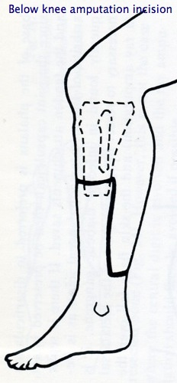

Slide 196
Above knee amputation
In this procedure the bone in the thigh (femur) is divided about 12-15 cm above the knee joint and the muscle and skin closed over the end of the bone.

Slide 197
Amputation related Complications
Hemorrhage
Infections
Skin breakdown
Phantom limb pain
Joint contractures

Slide 198
Assignment
Read and make notes on the following
Care of the stump.
Nursing care of patient undergoing amputation.

Slide 199
LOW BACK PAIN

Slide 200
Low Back Pains
Low back pains constitutes one of the most common reasons for seeking medical attention.
Approximately ˃ 84% of adults will have low back pain at some point. Some suffer from chronic or recurrent courses, with substantial impact on quality of life
Most episodes of low back pains are self-limiting
Treatment comprises a wide variety of approaches and no specific approach would be suggested as the most optimum.

Slide 201
Low Back Pains cont’d
Any structure in the back can cause pain, including ligaments, joints, periosteum, musculature, blood vessels, annulus fibrosus and nerves. Intervertebral discs and facet joints being the most commonly affected.
85% of those with isolated low back pains do not have a clear localization. There is no clear histopathology or anatomical location, and is commonly referred to as “strain” or “sprain”.
Age of onset is usually above 35 yrs old with men and women affected equally almost at the same rate.

Slide 202
Low Back Pains cont’d
Low back pains is the leading and expensive cause of work disability in those < 45 years
Risk factors Include:
Heavy lifting
Twisting and vibration exercises
Obesity.
Poor conditioning.

Slide 203
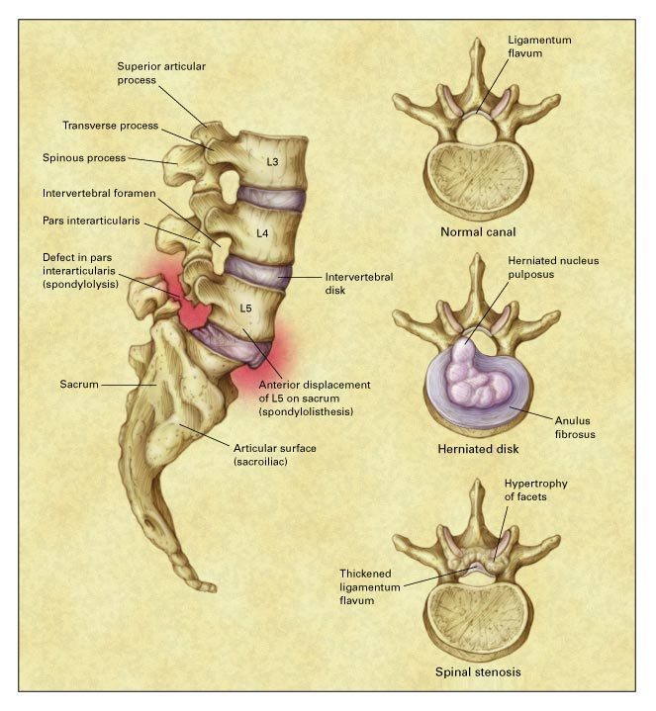
Common Pathoanatomical Conditions of the Lumbar Spine
Notes:
Figure 1. Common Pathoanatomical Conditions of the Lumbar Spine. A superior view of a lumbar vertebra with normal anatomy and canal configuration is shown in the upper right. In the superior view of a lumbar vertebra and intervertebral disk (center right), herniation of the nucleus pulposus into the spinal canal is evident. The nucleus pulposus has a soft consistency, at least from childhood to middle age, and may protrude through confluent fissures in the anulus fibrosus. This usually occurs in the lateral part of the spinal canal, as shown. The usual abnormalities that result in spinal stenosis (lower right) include hypertrophic degenerative changes of the facets and thickening of the ligamentum flavum. These processes may result in a severely narrowed canal, either centrally or in the lateral recesses of the canal. A lateral view of the lumbosacral spine, illustrating spondylolysis of the L5 vertebra with associated spondylolisthesis at L5-S1, is shown on the left. Spondylolysis refers to a defect in the pars interarticularis of the vertebra, which may be congenital or a result of stress fracture. Spondylolisthesis refers to the anterior displacement of a vertebra on the one beneath it. This may occur as a result of spondylolysis as shown (called isthmic spondylolisthesis) or as a result of degenerative disk disease, usually in the elderly. This process may contribute to narrowing of the spinal canal in spinal stenosis.

Slide 204
Diagnosis of Low Back Pain
History
Any evidence of systemic disease?
Age (especially >50),
History of cancer, unexplained weight loss, chronic infection.
Duration of illness
Presence of nocturnal pain
Response to therapy
Many patients with infection or malignancy will not have relief when lying down
For arthritis patients – young age, nocturnal pain and worsening with rest are common

Slide 205
Diagnosis of Low Back Pain cont’d
Any evidence of neurologic compromise e.g.
Cauda equina syndrome: a medical emergency usually due to a tumor or massive herniation compressing nerves at the cauda equina. Urinary retention with overflow, saddle anesthesia, bilateral sciatica, leg weakness, fecal incontinence.
Sciatica: a nerve root irritation characterised by sharp/burning pain down the posterior or lateral leg to foot or ankle; can be associated with numbness/tingling. If due to disc herniation often worsens with cough, sneeze or performing the Valsalva.

Slide 206
Diagnosis of Low Back Pain cont’d
Any evidence of neurologic compromise e.g:
(iii) Spinal stenosis: Caused by narrowing of the spinal canal, nerve root canals, or intervertebral foramina.
Most commonly due to bony hypertrophic changes in facet joints and thickening of the ligamentum flavum.
Disc bulging or spondylolisthesis may also cause back pain. Transient leg tingling, pain in calf and lower extremity that is triggered by ambulation and improved with rest, are common symptoms..
Can be differentiated from vascular claudication through detection of normal arterial pulses on exam.

Slide 207
Diagnosis of Low Back Pain cont’d
2. Physical Examination
Inspection of back and posture (ie. Scoliosis, kyphosis)
Range of motion
Palpation of the spine (vertebral tenderness sensitive for infection)
If high suspicion of malignancy, do a breast/prostate/lymph node exam
Peripheral pulses to distinguish from vascular claudication

Slide 208
Physical Examination
Straight leg raise: for those with sciatica or spinal stenosis symptoms
Patient supine, examiner holds patient’s leg straight
Elevation of less than 60 degrees abnormal and suggests compression or irritation of nerve roots
Reproduces sciatica symptoms (NOT just hamstring)
Ipsilateral straight leg raise sensitive but not specific for herniated disk
Crossed straight leg raise (symptoms of sciatica reproduced when opposite leg is raised) insensitive but highly specific

Slide 209
Physical examination
Neurologic examination
L5: ankle and great toe dorsiflexion
S1: plantar flexion, ankle reflex
Dermatomal sensory loss
L5: numbness medial foot and web space between 1st and 2nd toes
S1: lateral foot/ankle

Slide 210
Imaging
AP and lateral L-spine if no clinical improvement after 4-6 weeks
“Clinicians should not routinely obtain imaging or other diagnostic tests in patients with nonspecific low back pain” (American College of Physicians and American Pain Society).
Do perform x-rays if: fever, unexplained weight loss, hx of cancer, neurologic deficits, EtOH, age <18 or >50, trauma, immunosuppression, prolonged steroid use, skin/urinary infection, indwelling catheter

Slide 211
Imaging
CT and MRI
More sensitive for detection of infection and cancer than plain films
Also able to image herniated discs and spinal stenosis, which cannot be appreciated on plain films
Beware: herniated/bulging discs often found in asymptomatic volunteers → may lead to overdiagnosis/overtreatment
MRI better than CT for detection of infection, metastases, rare neural tumours

Slide 212
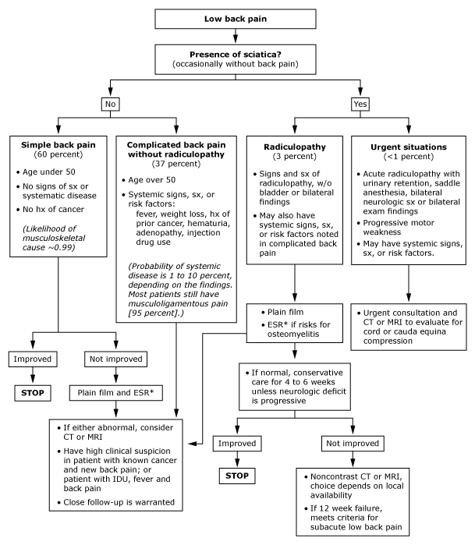

Slide 213
Natural History
Most recover rapidly
90% of patients seen within 3 days of symptom onset recovered within 2 weeks
Recurrences are common
Most have chronic disease with intermittent exacerbations
Spinal stenosis is the exception → usually gets progressively worse with time

Slide 214
Management of Low Back Pain
Non-specific low back pain
Regular NSAIDs and muscle relaxants good for symptomatic relief.
Spinal manipulation of limited utility in studies
Should recommend rapid return to normal activities with neither bed rest nor exercise in the acute period
Bed rest found to not improve and may delay recovery
Exercises not useful in acute phase; use in chronic

Slide 215
Therapy
Nonspecific low back pain
Traction, facet joint injections have minimal effects.
Systematic reviews of acupunture have shown little benefit
? Massage therapy have some promising results
Surgery only effective for sciatica, spinal stenosis or spondylolisthesis

Slide 216
Therapy
Herniated intervertebral discs
Nonsurgical treatment for at least a month
Exceptions: cauda equina syndrome, progressive neurologic deficits
Early treatment same as for nonspecific low back pain, but may need short courses of narcotics for pain control
Bed rest not useful
Some patients benefit from epidural corticosteroid injections
If severe pain, neurologic defecits consider MRI and surgery.

Slide 217
Therapy
Spinal stenosis
Physiotherapy to reduce risk of falls
Analgesics, NSAIDs, epidural corticosteroids
Decompressive laminecotomy
Spinal fusion with decompression if there is additional spondylolisthesis
Symptoms often recur, even after successful surgery

Slide 218
Therapy
Chronic low back pain
Intensive exercise improves function and reduces pain, but is difficult to adhere to
Anti-depressants: many with chronic low back pain are also depressed
? Maybe for those without depression (tricyclics)
Opiates
Small RCT showed better effect on pain and mood than NSAIDs
No improvement in activity
Significant side effects: drowsiness, constipation, nausea

Slide 219
Therapy
Chronic low back pain
Referral to multidisciplinary pain center
Cognitive-behavioural therapy, education, exercise, selective nerve blocks
Surgical procedures rarely helpful

Slide 220
SPONDYLOARTHRITIS

Slide 221
Introduction
Spondyloarthritis
Refers to inflammatory changes involving the spine and the spinal joints.
Remember – can sometimes have peripheral arthritis without spinal symptoms!
Seronegative Spondyloarthritis
Absence of Rheumatoid Factor
Psoriatic Arthritis
Ankylosing Spondylitis
Reactive Arthritis
Enteropathic Arthritis
Undifferentiated Spondyloarthropathy

Slide 222
Inflammatory vs. Mechanical Back Pain
Inflammatory
Mechanical
Age of onset < 40
Insidious onset
> 3 months duration
> 60 min am stiffness
Nocturnal pain
Improves with activity
Tenderness over SI joints
Loss of mobility in all planes
Decreased chest expansion
Unlikely to have neurologic deficits
Any age
Acute onset
< 4 weeks duration
< 30 min am stiffness
No nocturnal pain
Worse with activity
No SI joint tenderness
Abnormal flexion
Normal chest expansion
Possible neurologic deficits

Slide 223
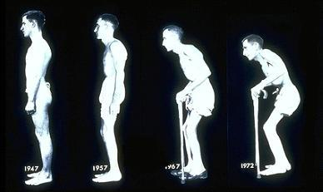
Clinical Features

Slide 224
Sacroiliitis
Usually bilateral and symmetric
Initially involves the synovial-lined lower 2/3 of the Sacro-iliac joint.
Early changes involves erosion on the iliac side of SI joint , the cartilage becomes thinner, and can cause “pseudo-widening” of SI joint.
Bony sclerosis, then complete bony ankylosis or fusion

Slide 225
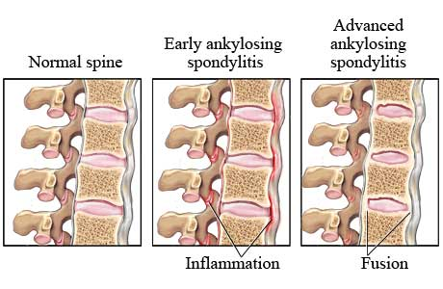
Spinal Involvement

Slide 226
Spinal Involvement
Gradual ossification of the outer layers of the annulus fibrosis (Sharpey’s fibers) form interverterbral bony bridges called syndesmophytes.
Fusion of the apophyseal joints and calcification of the spinal ligaments along with bilateral syndesmophyte formation can result in “bamboo spine”

Slide 227
Enthesitis
Enthesis: site of insertion of ligament, tendon or articular capsule into bone.
Enthesitis: Is the inflammation of enthesis resulting in new bone formation or fibrosis.
Common sites: SI joints, intervertebral discs, manubriosternal joints, symphysis pubis, iliac crests, trochanters, patellae, clavicles, calcanei (Achille’s or plantar fasciitis)

Slide 228
Treatment of Enthesitis
NSAIDs
Good for mild symptoms
Potentially disease modifying
Indomethacin seems to work the best
Beware of side effects, especially gastrointestinal disease

Slide 229
Treatment of Enthesitis
Disease – Modifying Anti-Rheumatic Drugs (DMARDs).
Sulfasalazine 1000-2000 mg bid
Seems to be the most effective for spinal symptoms.
Methotrexate 15-25 mg weekly
For patients with prominent peripheral arthritis
Doesn’t work very well for spinal symptoms

Slide 230
Treatment
Steroids
Not very effective at all in AS
Local injections for enthesitis or peripheral arthritis
Anti-TNFα agents
Remicade (infliximab), Enbrel (etanercept) and Humira (adalimumab)
Very useful for treating symptoms, improving ROM, improving fatigue
Hopefully disease-modifying . . .

Slide 231
MUSCULOSKELETAL DEFORMITIES

Slide 232
Musculoskeletal deformities
1.Congenital dislocation of the hip
Unilateral or bilateral hip dislocation can be diagnosed soon after.
If the diagnosis is missed the child will develop shortening and external rotation of the affected limb.

Slide 233
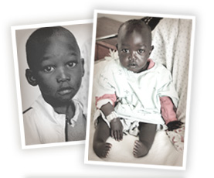
CLUB FOOT
Kids at cure international

Slide 234
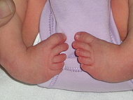
CLUB FOOT

Slide 235
THE NORMAL FOOT
Complex organ that is required to be
Stable: for supporting the body weight in standing
Resilient: for walking and running
Mobile: to accommodate variations of surface
Cosmetic

Slide 236
CLUB FOOT
Definitions
Talipes: Talus = ankle
Pes = foot
Equinus: (Latin = horse)
Foot that is in a position of
planter flexion at the ankle,
looks like that of the horse.
Calcaneus: Full dorsiflexion at the ankle

Slide 237
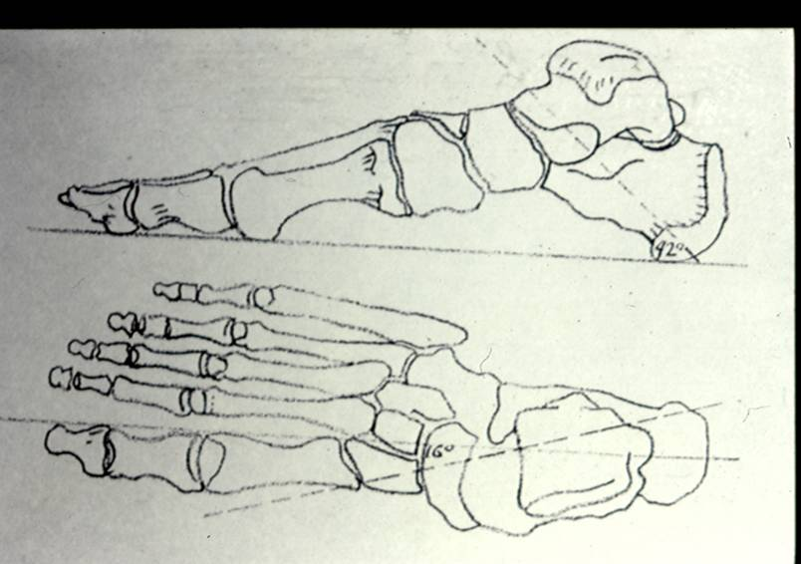
CLUB FOOT
Planus: flatfoot
Cavus: highly arched foot
Varus: heal going towards
the midline
Valgus: heel going away
from the midline
Adduction: forefoot going
towards the midline
Abduction: forefoot going away
From the midline
Forefoot
Hind foot

Slide 238


Slide 239
CLUB FOOT
Types
Idiopathic (Unknown Etiology) :
Congenital Talipes Equino-Varus CTEV
Acquired, Secondary to :
CNS Disease : Spina bifida, Poliomyelitis
Arthrogryposis
Absent Bone : fibula / tibia

Slide 240
Congenital Talipes Equino-Varus CTEV
Etiology
Some of these factors are :
Abnormal intrauterine forces
Arrested fetal development
Abnormal muscle and tendon insertions
Abnormal rotation of the talus in the mortise

Slide 241
Congenital Talipes Equino-Varus CTEV
Incidence
Occurs approximately in one of every 1000 live birth
In affected families, clubfeet are about 30 times more frequent in offspring
Male are affected in about 65% of cases
Bilateral cases are as high as 30 – 40 %

Slide 242
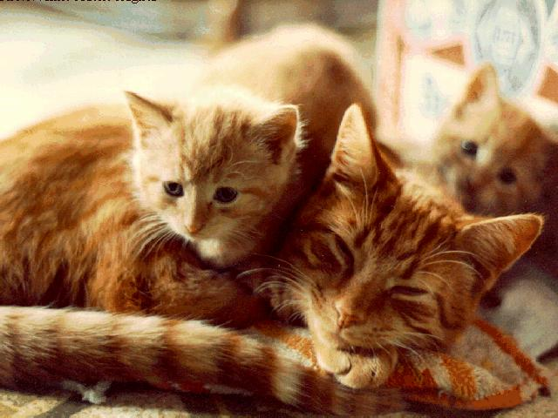

Slide 243
Congenital Talipes Equino-Varus CTEV
Basic Pathology
Abnormal Tarsal Relation
Congenital Dislocation / Subluxation
Soft Tissue Contracture
Congenital Atresia

Slide 244
Congenital Talipes Equino-Varus CTEV
Diagnosis
General Examination :
Exclude
Neurological lesion that can cause the deformity “Spina Bifida”
Other abnormalities that can explain the deformity
Presence of concomitant congenital anomalies
Syndromatic clubfoot

Slide 245
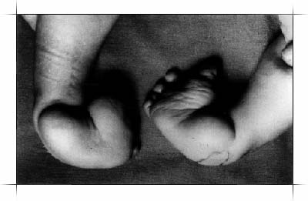
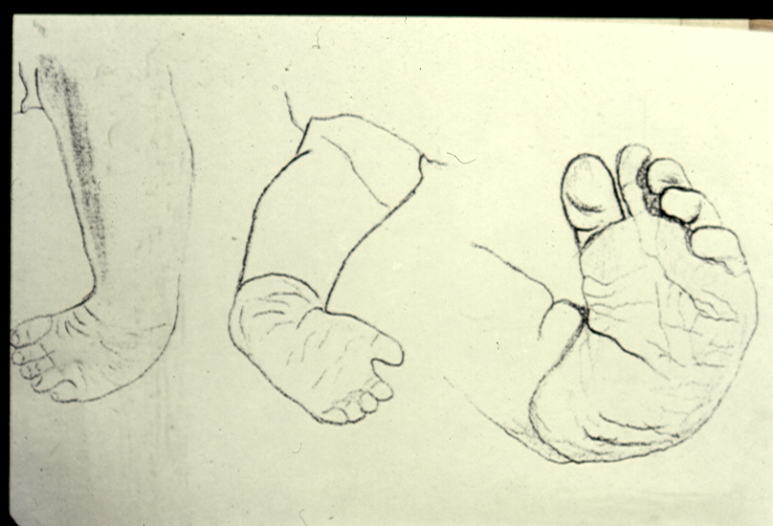
Congenital Talipes Equino-Varus CTEV
Diagnosis
“ Hind foot “ “ Fore foot “
Equinus, Varus Adduction, Supination, Cavus

Slide 246
Congenital Talipes Equino-Varus CTEV
Diagnosis
Short Achilles tendon
High and small heel
No creases behind Heel
Abnormal crease in middle of the foot
Foot is smaller in unilateral affection
Callosities at abnormal pressure areas
Internal torsion of the leg
Calf muscles wasting
Deformities don’t prevent walking

Slide 247


Slide 248
Congenital Talipes Equino-Varus CTEV
Treatment
The goal of treatment for clubfoot is to obtain a plantigrade foot that is functional, painless, and stable over time
A cosmetically pleasing appearance
is also an important goal sought by
the surgeon and the family

Slide 249
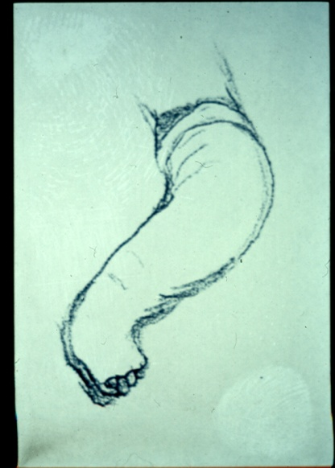
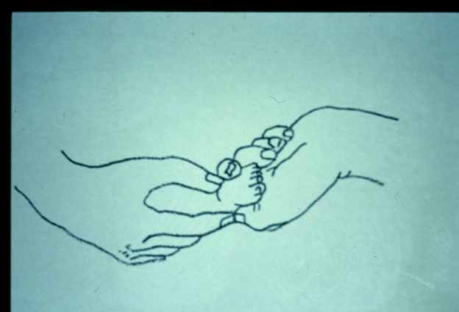
Congenital Talipes Equino-Varus CTEV
Treatment
Non surgical treatment should begin shortly after birth
Gentle manipulation
Immobilization
- Strapping ????
- POP or synthetic cast

Slide 250
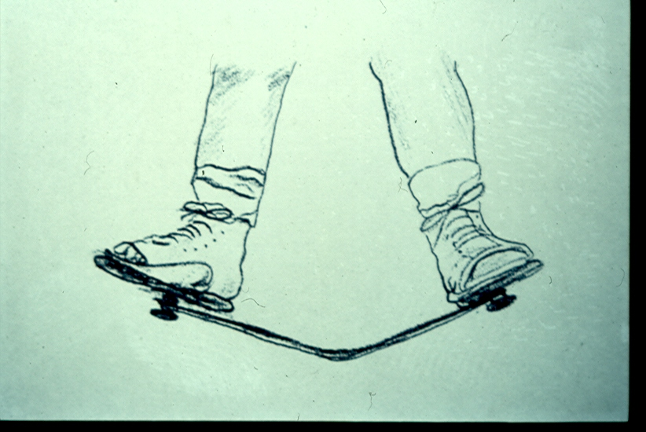
Congenital Talipes Equino-Varus CTEV
Treatment
Non surgical treatment should begin shortly after birth
Splints to maintain correction
- Ankle-foot orthosis ????
- Dennis Brown splint

Slide 251
Congenital Talipes Equino-Varus CTEV
Treatment
Manipulation and serial casts
Validity, up to 6 months !
Technique “Ponseti”
Avoid false correction
When to stop ?
Maintaining the correction
Follow up to watch and avoid recurrence

Slide 252
Congenital Talipes Equino-Varus CTEV
Treatment
Ponseti technique
Always use long leg casts, change weekly.
First manipulation raises the 1st metatarsal to decrease the cavus
All subsequent manipulations include pure abduction of forefoot with counter-pressure on neck of talus.
Never pronate !
Never put counter pressure on calcaneus or cuboid.

Slide 253
Congenital Talipes Equino-Varus CTEV
Treatment
Ponseti technique (cont.)
Cast until there is about 60 degrees of external rotation (about 4-6 casts)
Percutaneous tendo Achilles tenotomy in cast room under local anesthesia, followed by final cast (3 weeks)
After final cast removal, apply Normal last shoes with Denis Browne bar set at 70 degrees external rotation (40 degrees on normal side)
Denis Browne splint full time for two months, then night time only for two-four years.
35% need Anterior Tibialis tendon transfer at age 2-3

Slide 254
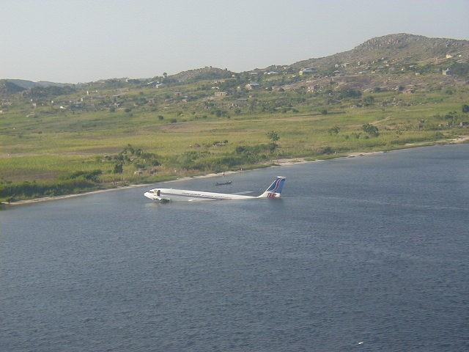

Slide 255
Congenital Talipes Equino-Varus CTEV
Surgical Treatment
Indications
Late presentation, after 6 months of age !
Complementary to conservative treatment
Failure of conservative treatment
Residual deformities after conservative treatment
Recurrence after conservative treatment

Slide 256
Congenital Talipes Equino-Varus CTEV
Surgical Treatment
Types (soft tissue and bony operations)
Time of surgery
Selection of the procedure and the incision
Post operative care
Follow up
Complications

Slide 257
Congenital Talipes Equino-Varus CTEV
Surgical Treatment
Soft tissue operations
Release of contractures
Tenotomy
Tendon elongation
Tendon transfer
Restoration of normal bony relationship

Slide 258
Congenital Talipes Equino-Varus CTEV
Surgical Treatment
Bony operations
Indications
Usually accompanied with soft tissue operation
Types:
- Osteotomy, to correct foot deformity or int. tibial torsion
- Wedge excision
- Arthrodesis (usually after bone maturity)
one or several joints
- Salvage operation to restore shape.

Slide 259
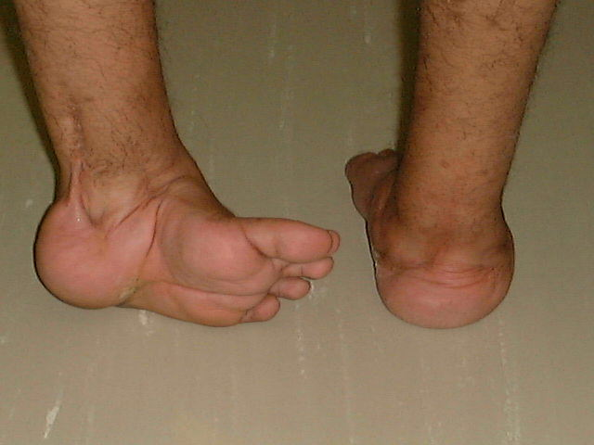
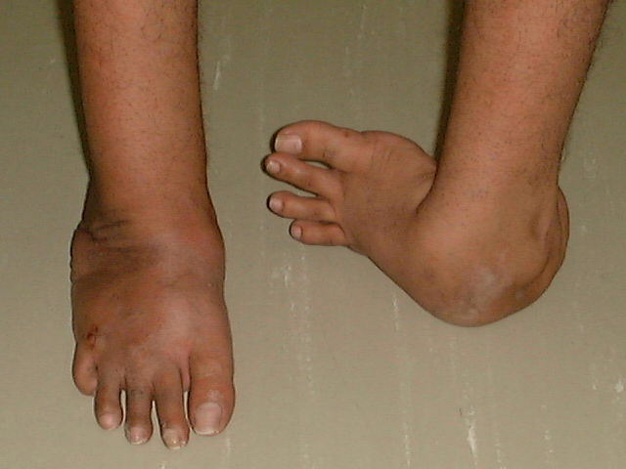
Congenital Talipes Equino-Varus CTEV
Surgical Treatment

Slide 260
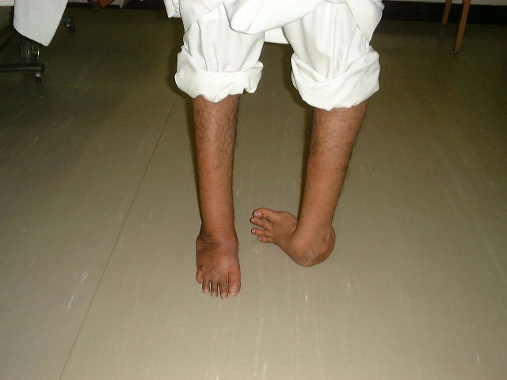
Congenital Talipes Equino-Varus CTEV
Surgical Treatment

